Slide 1
FORENSIC DENTAL X-RAY IMAGE ENHANCEMENT USING CLAHE AND FAG TO DETERMINE AGE DOMAIN: DEEP LEARNING

Slide 2
OVERVIEW
For our experiments, the first and last phases are the same. More specifically, the first phase is related to the objective of predicting crime; consequently, the aim is to investigate several predictive models.
The last phase involves the reporting of the results of this investigation. The variations in the other phases for each experiment are presented in dental crime prediction. In relation to the modeling phase, it typically involves building a model using some of the data available; this data is referred to as the training set.
The remaining data is used for evaluating the performance of the model (in the evaluation phase), and it is referred to as the test set. The model itself can be built using a CLAHE and FAG algorithm. The following subsection describes the algorithms used in our experiments.

Slide 3
LITERATURE SURVEY
Title: 3D Dental Biometrics Automatic Pose-invariant Dental Arch Extraction and Matching
Authors: Zhivuan Zhang, Xin Zhong
Year: 2020
Methodology used: Radial Ray Algorithm (RRA)
Observations:As best as we know, this is the first attempt at automatic dental arch extraction and matching for 3D dental identification
Pros:It has speed advantages to match twice for each PM arch
Cons:
1.blur makes radiographs feature even we need extraction difficult
2. imaging angle change problems make those features inaccurate thus impossible to match against AM records in the database

Slide 4
Title: Estimating Hard-tissue Conditions from Dental Images via Machine Learning
Authors: Jingxuan Bao, Mansu Kim, Qing Sun, Anderson T. Hara , Gerardo Maupome and Li Shenk
Year: 2020
Methodology used:Trees Regression is an algorithm
Observations:Despite the great success of machine learning in various biomedical domains, applications to dental hard tissue conditions
Pros:Our prediction models employ two different feature representations as the predictor and aim to estimate probability or severity score as a response
Cons:in terms of Pearson correlation measurement. In this summary, most of the nine machine learning methods are not sensitive to the bin number

Slide 5
Title: Improving the Efficiency of Dental Implantation Process Using Guided Local Search Models and Continuous Time Neural Networks With Robotic Assistance
Authors: MOHAMED HASHEM 1 , MONIS LUQMAN MOHAMMED2 , AND AHMED E. YOUSSEF
Year: 2020
Methodology used: Applying the Meta heuristic guided algorithm
Observations:Nowadays, robotics plays a vital role in medical applications, especially in dentistry, where robots can track oral hygiene and perform dental surgeries.
Pros:According to their discussions, dental implants have several advantages such as feeling like own teeth in appearance, enhancing speech, feeling comfort, eating easier, improving self-esteem, and enhancing oral health, durability, and convenience.
Cons:Neural networks are used in different medical applications such as Detecting dental problem related brain disease

Slide 6
Title: UNet Architecture Based Dental Panoramic Image Segmentation
Authors: S. Sivagami1, P. Chitra2, G. Sri Ram Kailash3, and S.R. Muralidharan
Year: 2020
The methodology used: Watershed Algorithms
Observations: proposes an UNet architecture that uses convolutional neural networks to achieve accurate segmentation of Dental panoramic x-ray images
Pros:ReLU is easier to try and attains better performance than other activation functions, so ReLU is one of the added advantages of UNet architecture.
Cons: In this paper, UNet architecture is the proposed model for accurate segmentation of panoramic radiographic dental

Slide 7
Title: Classification of Digital Dental X-ray Images Using Machine Learning
Authors: Sindu Divakaran, K. Vasanth, Suja D, Swedha V.
Year: 2021
The methodology used: Support Vector Machine (SVM), Artificial Neural Network (ANN) and KNN (Kernal Nearest Neighbour) classification algorithm
Observations:Dental diseases like dental anomalies, periapical and dental caries is increasing day by day
Pros:A better penetration of machine learning into these processes highlights its advantages to classify dental X ray images
Cons: Once anomalies are detected in an X-Ray, the doctor diagnosis the problem and prescribe the therapy

Slide 8
Title: Anomaly detection in panoramic dental x-rays using a hybrid Deep Learning and Machine Learning approach
Authors: Dhruv Verma , Dr Sunaina Puri , Dr Srikanth Prabhu and Dr Komal Smriti
Year: 2021
The methodology used: We used a pre-image processing algorithm
Observations:Automated anomaly detection in panoramic dental x-rays is a crucial step in streamlining post diagnosis treatment
Pros:One major advantage of a CNN is that it is able to learn features from an input automatically
Cons: The softmax activation was chosen as a final activation due to the task being a binary classification problem where each class is mutually exclusive

Slide 9
Title: Dental work extraction for different radiographic Images in human Forensic Identification
Authors: G.jaffino, A.Banumathi, j.prabin jose
Year: 2021
The methodology used: Clustering algorithm
Observations: The dental radiograph image provides information about teeth, tooth contours and in addition to that dental work (DW) is one of the notable issues for forensic identification
Pros: The dental work for different radiographic images is extracted by using the clustering technique
Cons: In this paper addresses the problem of dental work extraction and matching technique in-person identification is presented

Slide 10
Title: Tooth Restoration and Dental Work Detection on Panoramic Dental Images via CNN
Authors: Anil Gurses, Ayse betul oktay
Year: 2021
The methodology used:R-CNN algorithm
Observations: Dental radiography is crucial for clinical treatment, diagnosis and surgery since the dental images include a lot of information about teeth and other structures
Pros: The automated detection of dental work can be used for human identification
Cons: Implants are detected with higher accuracy with all CNNs while the fillings are detected with the lowest accuracy

Slide 11
Title: Conventional vs. Digital dental impression: practitioner’s and patient’s perspective-a pilot study
Authors: Danijela Kalibovic Govorko, Benjamin Benzon, Katarina,
Year: 2021
The methodology used: Orthodontists algorithm
Observations: Dental cast is an indispensable part of a routine diagnostic and therapeutic procedure
Pros: the recent systematic review of Bohner et al. showed that the current digital technologies are reported to be accurate for specific applications, but the scanning of edentulous arches still represents a challenge
Cons: After the impression-taking, all participants answered that digital impression technique would spare more time in their office

Slide 12
Title: A Quantitative Measurement of Hand Scaling Motion for Dental Hygienist Training
Authors: Tomoko yui, Tomoki Ishikura, SungGwi Cho,
Year: 2022
The methodology used: R-CNN algorithm
Observations:To make this training more efficient, we need to measure the students' skills and show correction points in real-time
Pros:The proposed method has many advantages. First, the method does not need any parameters
Cons: The scaling force applied to molars is similar to that applied to front teeth. There is also research on the orthodontic force of teeth

Slide 13
PROBLEM DEFINITION
An adaptive gamma correction (AGC) method to enhance dark and bright contrast images to mitigate this problem. The classification of dark images and bright images is based on the mean intensity of the image.
In the assumed that pixels with mean intensity greater than or equal to 0.5are classified as bright pixels, and the mean intensity of less than 0.5 is classified as dark pixels.
Then, the classifications of image pixels are enhanced using different types of transformation functions. In addition, the gamma correction factor is calculated dynamically for each image according to its statistical information.
Although histogram-based enhancement techniques, namely histogram equalization (HE), is able to provide better vein enhancement than the conventional spatial domain technique, it poorly equalizes every local detail.
This is because HE transformed the original histogram of the entire image into a uniformly distributed histogram, resulting in a loss of visibility.

Slide 14
FEASIBILITY STUDY
The feasibility of the project is analyzed in this phase and business proposal is put forth with a very general plan for the project and some cost estimates.
During system analysis the feasibility study of the proposed system is to be carried out. This is to ensure that the proposed system is not a burden to the company.
For feasibility analysis, some understanding of the major requirements for the system is essential.
1.ECONOMICAL FEASIBILITY
The system developed and installed will be good benefit to the organization.
The system will be developed and operated in the existing hardware and software infrastructure. So, there is no need of additional hardware and software for the system.

Slide 15
2. TECHNICAL FEASIBILITY
Does the necessary technology exist to do what is been suggested?
Does the proposed equipment have the technical capacity for using the new system?
Are there technical guarantees of accuracy, reliability and data security?
The project is developed on i3,i5,i7 with 6 GB RAM.
The environment required in the development of system is any windows platform
The observer pattern along with factory pattern will update the results eventually
The language used in the development is PYTHON 3.10 & Windows Environment 3.3

Slide 16
3. SOCIAL FEASIBILITY
The aspect of the study is to check the level of acceptance of the system by the user. This includes the process of training the user to use the system efficiently. The user must not feel threatened by the system, instead must accept it as a necessity.
The level of acceptance by the users solely depends on the methods that are employed to educate the user about the system and to make him familiar with it. His level of confidence must be raised so that he is also able to make some constructive criticism, which is welcomed, as he is the final user of the system.

Slide 17
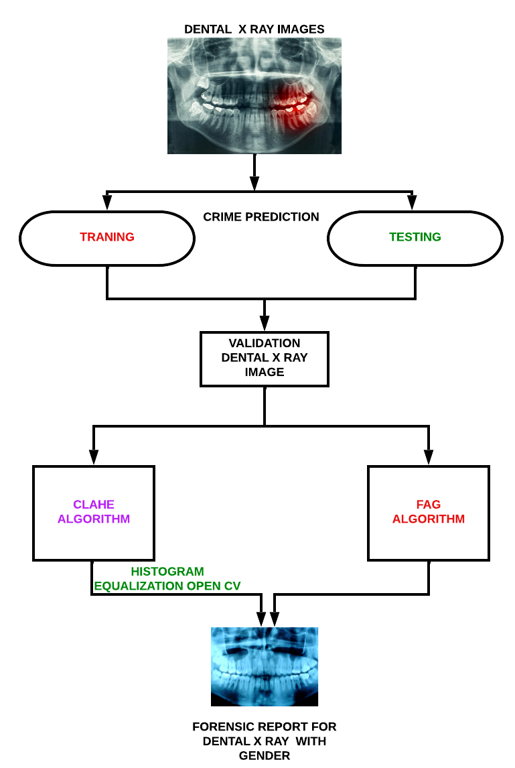
SYSTEM ARCHITECTURE

